Slide 1
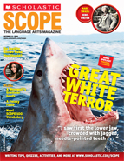
Magazines
Understanding
Nonfiction
Text
Text Features
Inside
Examples of Text Features
Features With Definitions
Explanations for how Text Features Help Readers
Text Features Help Students Understand Nonfiction Text

Slide 2
What are text Features?
Authors include text features to help readers better understand what they have read.
Text features provide information that may not be written in the text itself.
Text features can be found in textbooks, magazine articles, newspapers, reports, web pages, and other forms of nonfiction text.

Slide 3
Table of Contents
Table of Contents
Chapter 1: All About Animals
Animal Adaptations Page 1
Animal Food Page 2
Animal Habitats Page 3
Animal Homes Page 4
Chapter 2: All About Plants
Photosynthesis Page 5
Types of Plants Page 6
Where would a reader find information where an animal lives?
List the major parts of a book along with their page numbers.
It outlines the main topics or main points.
Readers can use the table of contents to help locate information in the book and see how everything is organized.

Slide 4
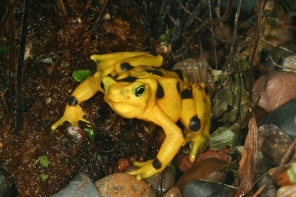
Index
A
Abu Simbel, temple of, p73
Acadia, Canada, 212-213
Acid rain, 396
Animal Adaptations p1
Animal Food p2
Animal Habitats p3
Animal Homes p5
Where would a reader find information in the text about acid rain?
Is an alphabetical listing of the key names, terms, events, and topics with page numbers.
Readers use the index to help find pages that contain information they are looking for.

Slide 5
Glossary
A
Acid rain (AS ihd rayn) rain
that carries certain kind of pollution.
Adapt (uh DAPT) to change in order to survive in new environments
* How would the glossary help the reader understand text bout animal adaptations?
A list of key terms in alphabetical order.
Each key word is defined.
Sometimes a glossary also tells you how to pronounce a word.
Readers use the glossary to look up key terms to find out their meaning. This helps the reader better learn and understand the subject.

Slide 6
Titles
Titles tell the reader the topic of the text.
Titles show the main idea of the text.
Titles help the reader by letting them know what they are about to read.
Titles focus the reader on a topic they can make connections between what they already know and the text.
What do the titles of the articles in these magazines tell you?

Slide 7
Subheadings
Helpful Ants
Although ants are frustrating when they get in homes, ants do help the environment. They help control the population of damaging pests such as termites.
Types of Ants
Types of ants include fire ants, which cause a painful sting, and carpenter ants, which damage wood structures while nest building. Other types of ants include honey, pharaoh, house, Argentine, and the their ant.
Subheadings divide the text into sections.
Subheadings tell the main idea of each section of text.
They are printed in large or bold type to make them stand out .
Subheadings help the reader to locate information in the text by telling them where to look.

Slide 8
Text Styles (Bold, Color, & Italics)
The Wetlands of the South
Why are the South’s wetlands so important?
The Okefenokee (oh kuh fuh NOH kee) Swamp is a large wetland in the South. A wetland is a place where the ground is soaked with water for at least part of the year.
The style and color of the text sends the reader signals about how to read the content.
Key words to notice are in bold or in color.
Text in italics is used in picture captions, book titles, and any other element that needs to stand out.
Text in bold, color, or italics draw the readers attention to important information.
How do the words in italics help the reader understand the text?

Slide 9
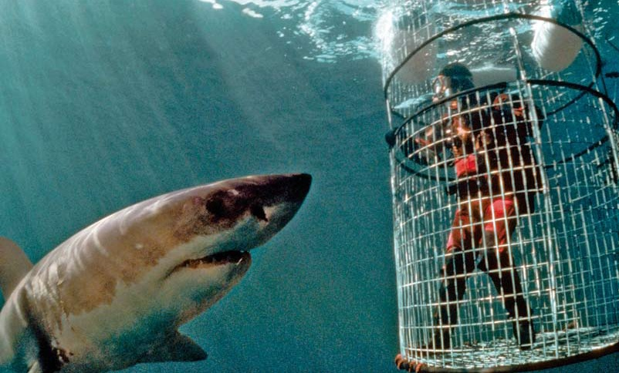
Photographs and Illustrations
Photos and illustrations give information in a visual way.
They help tell the story.
They work with the words and headings to help teach material.
They help the reader understand an idea from the text that was unclear.
How might these photos help the reader understand the text?

Slide 10
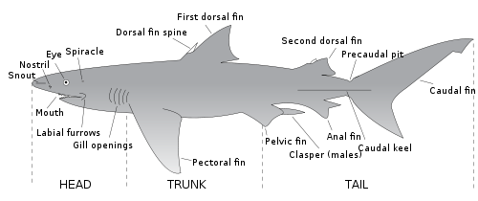
Diagrams
Physical Characteristic of the Shark
A diagram is a drawing that shows or explains something.
To understand a diagram the reader should read the titles, labels, captions, and numbered parts.
Diagrams help the reader understand steps, how objects are made, or information in the text.

Slide 11
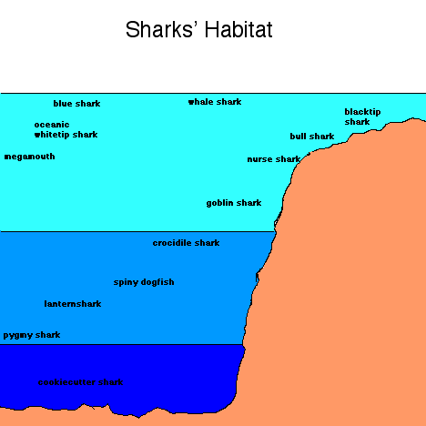
Chart
A chart is a graphical representation of data.

Slide 12
Fatal Great White Shark Attacks In the United States Timeline
4/25/08 California
8/15/04 California
8/19/03 California
12/9/94 California
4/16/94 California
1/26/89 California
9/15/84 California
Timelines show important events in chronological order or time order.
Timelines help the reader better understand the order of events and how one event may have lead to another.
How would a timeline help a reader understand an article about Great White Sharks?

Slide 13
Timeline Links
http://www.dipity.com/timeline/Shark-Attack-Florida#flip
http://www.marthas-vineyard-vacation-tips.com/jaws-movie-clips.html

Slide 14
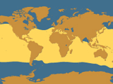
Maps
Maps are drawings that show the basic shape of the land and other geographical, political, or historical features.
The present information in a visual form.
They help the reader understand where an event happens.
They help the reader understand how far away an event took place.
The Range of the Great White Shark
What does the above map display? How does it help you understand Great White Sharks?

Slide 15
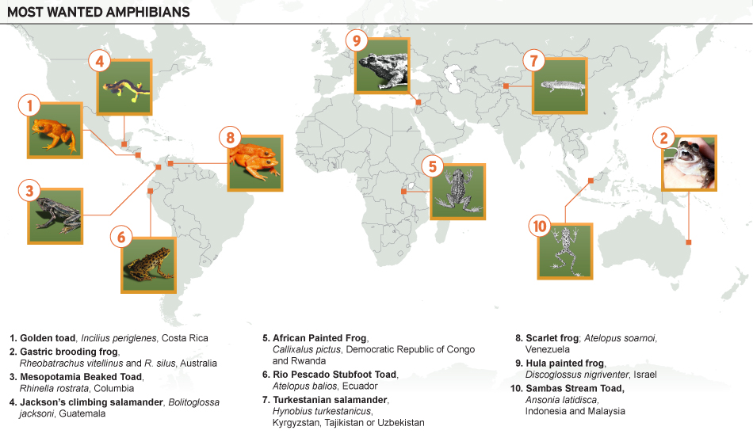

Slide 16
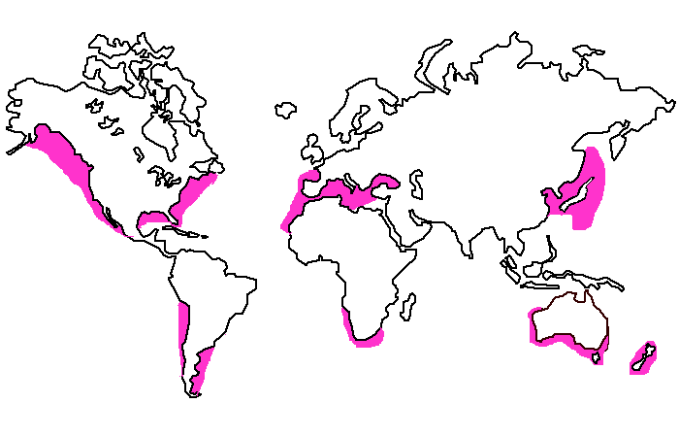
Great White Shark Map

Slide 17
Tables
Tables organize large amounts of information is a small space.
Tables present all kinds of data, from numbers and amounts, to calendars and menus.
Tables help the reader compare information in the text.
 | REPTILES | AMPHIBIANS
Covering | Scales. Many reptiles shed their skin,having grown new skin underneath it. Snakes & most lizards do not have eyelids.The eye is covered by a clear scale that sheds with the rest | Skin. It is thin and needs to be kept moist. Assists in the animal's breathing.
Life Cycle | Males and females mate in order for young to start developing. The males put sperm inside the female's body. Some reptiles lay eggs, some give birth to live young. Young generally look like the adults. | Males may add sperm to eggs after they are laid, or may put the sperm into female's body before eggs laid. Sperm added to the eggs make young develop inside. Females lay eggs, which hatch into larvae which have gills & live in water(eg tadpoles). These develop and change into air-breathing adults. In a few kinds, the entire tadpole stage takes place in the egg or in mother's body.

Slide 18
Byline
A byline is who wrote the article. A byline may be at the beginning or end of the article.

Slide 19
Textbox
AUTHOR PETER BENCHLEY WROTE JAWS, A BEST-SELLING NOVEL ABOUT A MONSTROUS GREAT WHITE SHARK. BUT WHAT HAPPENED WHEN HE FACED ONE OF THESE CREATURES FOR REAL? BY PETER BENCHLEY
A textbox provides more information that is in the text about a topic.
A textbox can include interesting facts or important information the author wants the reader to know.
Textboxes help readers understand by creating interest or emphasizing important information.
How does this textbox give you insight into the article?

Slide 20
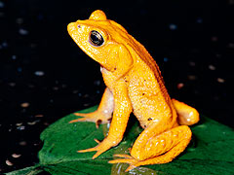
Captions
A caption explains what is shown in a picture or illustration.
Captions help the reader understand information that may or may not be in the text.
The golden toad of Costa Rica went missing in 1989. Its bright color is unusual for a toad species. However, only male golden toads were this color. Females were green or black.
How does this caption help the reader understand the picture?

Slide 21
Types of News Categories
Education
Entertainment
Science
Arts
Health
Sports

Slide 22
Magazines
Find an article and find an example of each text feature.
Explain how each example helps you to understand what you read.
Inside
Great White Terror
The Hunt For Lost Frogs

Slide 23
Questions To Help You Preview Your Article
What do headings and subheadings tell me about the topic?
What information do photographs, diagrams, illustrations, and captions provide?
What subjects are mentioned in the first sentences of paragraphs?
What kinds of statistics, quotations from experts, or facts appear in the text?

Slide 24
Text Features
Entertainment Article
Science Article
Content intended for informational or leisure reading
Illustrations or photographs accompany the text
Text may be written for a general or specific audience
Technical language
Educational purpose
Visual aids such as diagrams with captions
Text written for an audience of people with an interest in science

Slide 25
Text Features Quiz
Shark Article
Frog Article
What is the title of the article?
Who wrote the byline?
What is a subtitle of the article?
Describe a photograph in the article in a complete sentence? Does it create a mood?
What is the title of the article?
Who wrote the byline?
What is a subtitle of the article?
Describe a photograph in the article in a complete sentence? Does it create a mood?

Slide 26
Text Features Quiz
Shark Article
Frog Article
Does the article have a chart, graph, or diagram? Describe the visual aid and its purpose?
Does the article have a text style? Describe the text style and its purpose?
Does the article have a caption? What is the purpose of the caption?
Does the article have a chart, graph, or diagram? Describe the visual aid and its purpose?
Does the article have a text style? Describe the text style and its purpose?
Does the article have a caption? What is the purpose of the caption?

Slide 27
Text Features Quiz
Shark Article
Frog Article
8. Does the article have a web link? Copy the web link
9. Does the article have any scientific terms? What is the definition of one of the terms?
10. In what news category would you put this article?
Education, Entertainment, Science, Arts, or Health
8. Does the article have a web link? Copy the web link
9. Does the article have any scientific terms? What is the definition of one of the terms?
10. In what news category would you put this article?
Education, Entertainment, Science, Arts, or Health

Slide 28
Is the truth the same for everyone?
Historians
Scientist
Historians identify and verify the truth using historical records.
Scientist hypothesize, experiment, and observe.

Slide 29
Diagram

Slide 30
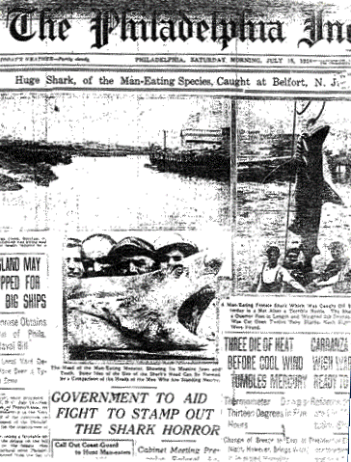
July 15, 1916
The Philadelphia Inquirer reported the capture of a "man-eating" shark off the Jersey Shore after the attacks.
The Jersey Shore shark attacks of 1916 were a series of shark attacks along the coast of New Jersey between July 1 and July 12, 1916, in which four people were killed and one injured. Since 1916, scholars have debated which shark species was responsible and the number of animals involved, with the great white shark and the bull shark most frequently being blamed. The attacks occurred during a deadly summer heat wave and polio epidemic in the northeastern United States that drove thousands of people to the seaside resorts of the Jersey Shore. Shark attacks on the Atlantic Coast of the United States outside the semitropical states of Florida, Georgia, and the Carolinas were rare, but scholars believe that the increased presence of sharks and humans in the water led to the attacks in 1916.

