Slide 1
The greatness in you

Slide 2
Realizing the Impact of Your Individual Greatness

Slide 3
Challenges Ahead

Slide 4
World Population 7.5 billion now 9.8 billion by 2050 U.S. 428 million by 2050

Slide 5
Resources Environment Geopolitics Individual Freedoms

Slide 6
Overwhelming?

Slide 7
How do you eat an elephant?

Slide 8
Your personal daily impact on the world around you.

Slide 9
Home Profession Community Country

Slide 10
How can YOU be the best that you can be each day?

Slide 11
Men can starve from a lack of self-realization as much as they can from lack of bread. Richard Wright

Slide 12
Maslow's (1943, 1954) hierarchy of needs is a motivational theory in psychology comprising a five tier model of human needs, often depicted as hierarchical levels within a pyramid.

Slide 13
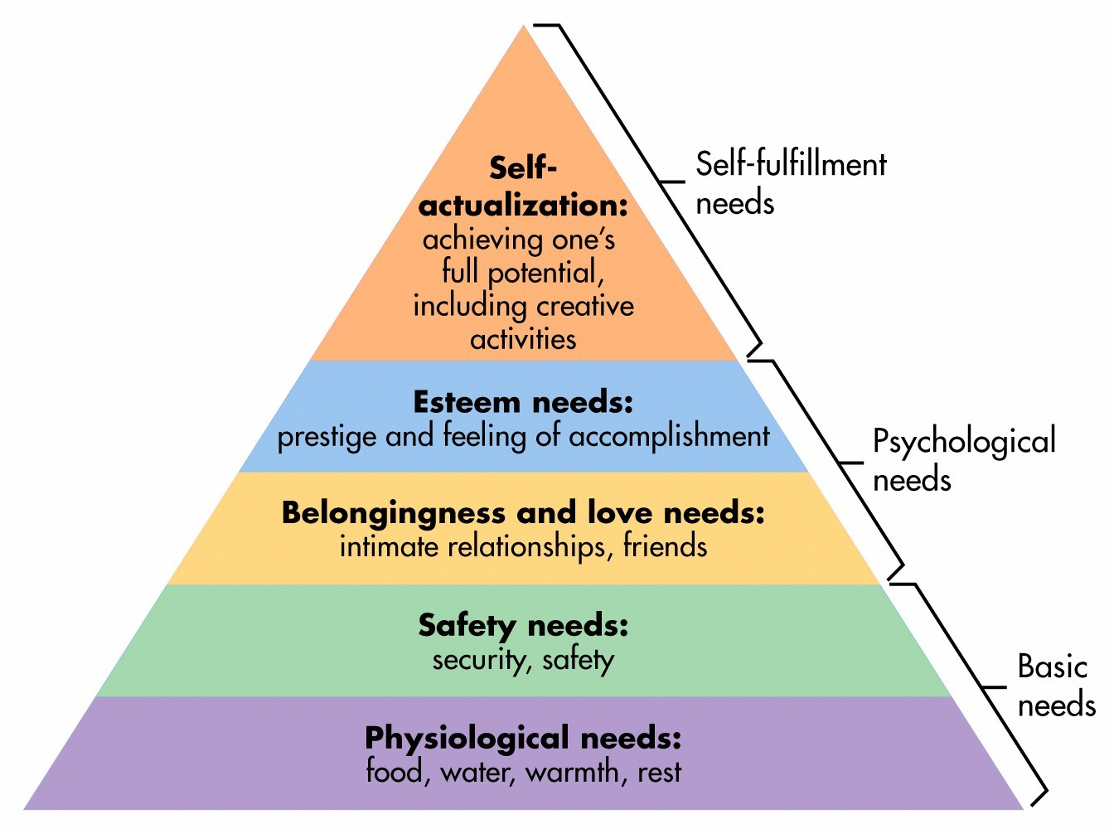

Slide 14
Full potential? Including creativity?

Slide 15
Characteristics of Self-Actualizers

Slide 16
- Accept themselves/others for what they are - Spontaneous in thought and action - Problem-centered (not self-centered)

Slide 17
- Able to look at life objectively - Highly creative - They perceive reality efficiently and can tolerate uncertainty

Slide 18
- Concerned for the welfare of humanity - Establish deep satisfying interpersonal relationships with a few people

Slide 19
- Democratic attitudes - Strong moral/ethical standards - Capable of appreciation of basic life-experience

Slide 20
Forces working against your self-actualization.

Slide 21
Personal insecurities

Slide 22
Inertia

Slide 23
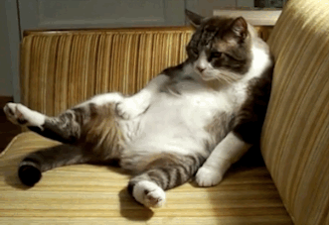

Slide 24
CONFORMING TO THE STATUS QUO

Slide 26
MEDIOCRITY

Slide 28
LEVEL OF COMPETITION

Slide 29
Your level of achievement is only limited by your imagination and drive.

Slide 30
Behavior Leading to Self-Actualization

Slide 31
- Experiencing life like a child, with full absorption and concentration - Trying new things instead of sticking to safe paths

Slide 32
- Listening to your own feelings in evaluating experiences instead of the voice of tradition, authority or the majority

Slide 33
- Taking responsibility and working hard - Trying to identify your defenses and having the courage to give them up

Slide 34
- Being prepared to be unpopular if your views do not coincide with those of the majority

Slide 35
Identifying opportunities or issues and stepping forward in a leadership role.

Slide 36
If you step forward to lead, if you step forward to offer new insights, if you identify innovative approaches to old issues…

Slide 37
Using your intellect, creativity, and energies to be a leader in your school, university, career, community, or country.

Slide 38
This may take some practice so look for leadership training or creative thinking opportunities.

Slide 39
Goal: To reach self-actualization in as many segments of your life as possible.

Slide 40
- Summa Cum Laude - Leadership in your community. - Being a leader in your profession. - Helping to solve institutional or social problems. - Political leadership.

Slide 41
Lofty goal, but we need leaders like you because without your intellects and dreams our country and world cannot and will not thrive.

Slide 42
Sometimes those who favor the status quo will fight against change and you will need to persevere.

Slide 43
Realizing that your individual GREATNESS will systematically impact our country and our globe.

Slide 44
. Be a leader be Great!

